Slide 1
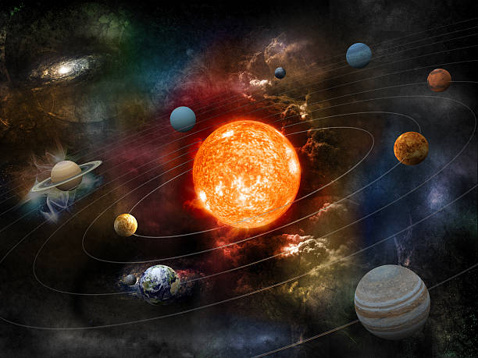
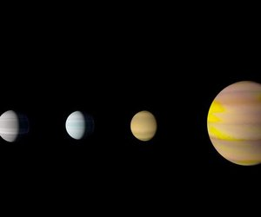
Nasa Space App Challenge 2024
Orrery Web App
Create an Orrery Web App that Displays Near-Earth Objects
Anonymous Faces :
Leader – Onkar Chavan
Bhargav Patil
Aditya Ukirde
Ritesh Narsale

Slide 2
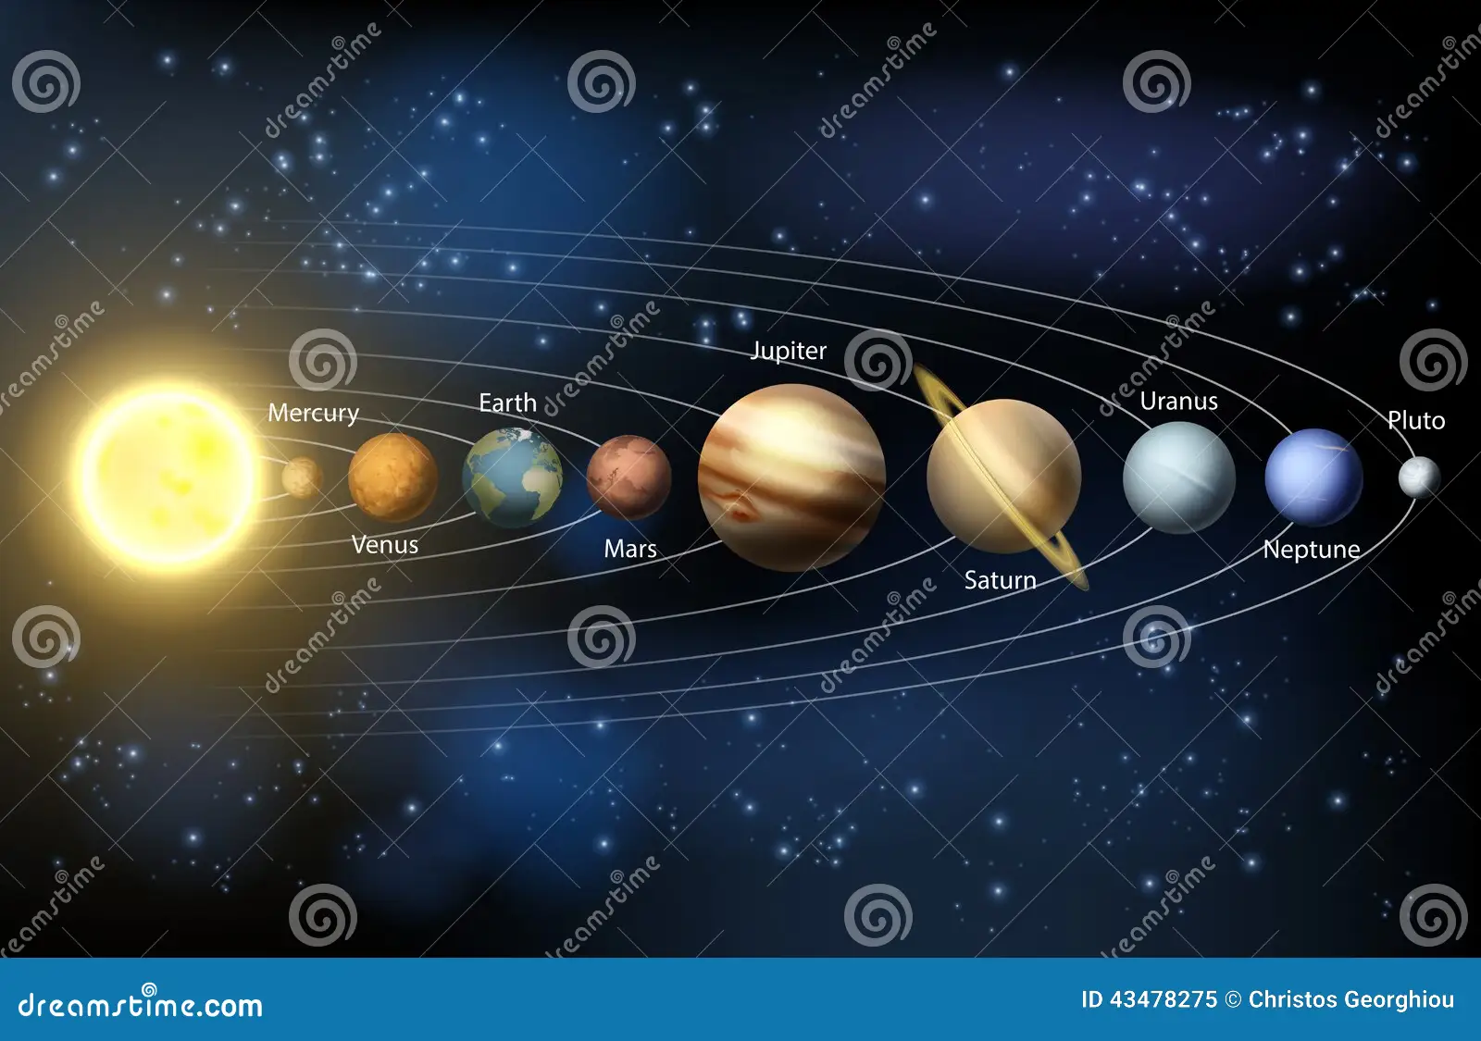
Orrery Web App that Displays Near-Earth Objects
Since a mechanical model of the solar system was presented to Charles Boyle, 4th Earl of Orrery, in 1713, such models have been referred to as orreries. The first orreries were physical models, but now days we get everything on internet
that’s why the orrery web app is needed for anyone for their understanding about space, how actual planets are, how can they rotate etc. It is a way to know about space solar system.
So, what should we do If we want to know more about space, solar system or we have interest about such space things.
It’s important to us to know about our solar system about our space.

Slide 3
Introduction to Orrery web App
The Orrery Web App is an interactive digital tool designed to visualize the solar system's planetary motions. Inspired by traditional mechanical orreries, which simulate the movement of celestial bodies, this web application offers users a modern, accessible experience to explore the universe from their browser.
By leveraging real-time data, the app allows users to view the relative positions and orbits of planets in an engaging and educational way. It provides essential features such as a user-friendly menu, a home page with an overview of the solar system, a dynamic search bar for locating specific planets or objects, and filter options for a customized view.
Whether you're a student, educator, or space enthusiast, the Orrery Web App offers a powerful and immersive experience, bringing the cosmos closer to everyone.

Slide 4
Understanding the complex movements of celestial bodies can be difficult, especially with traditional static models or textbook diagrams. Our Orrery Web App solves this problem by providing an interactive, real-time simulation of the solar system, allowing users to easily visualize planetary motions, relative positions, and orbits.
It bridges the gap between complex astronomical concepts and accessible learning by offering:
Real-time visualization of planetary orbits, making it easier to grasp the dynamics of the solar system.
Search and filter features, allowing users to find and explore specific planets or objects with ease.
A user-friendly interface that caters to students, educators, and space enthusiasts, enabling them to engage with astronomy in a more intuitive and immersive way.

Slide 5
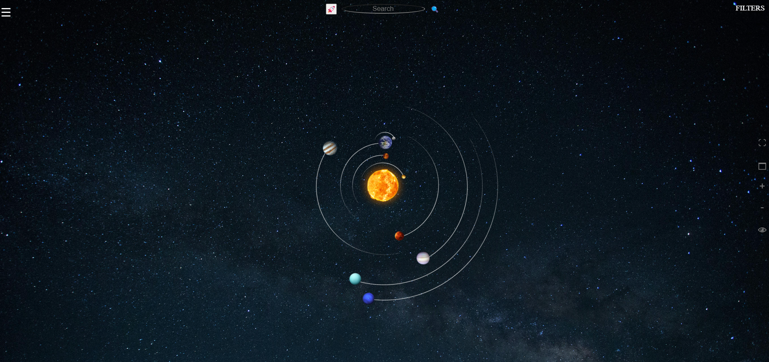
Orrery Web App Interface

Slide 6
Summary:
We can understand what is solar system.
We get information about planets and their orbits.
We can see how actual planet looks like and rotates.
We can get information about any comet, asteroids, satellite by searching.
Futurastic Use:
We can use this as a space map after some modification.
We can detect near objects of our spacecraft.
It can sense coming and near comets, asteroids after some modification.

Slide 7
Thank You

